Slide 1
Subject: Electricity Laboratory
Experiement 6: Determination of Resistance of Resistors in Series in Simple Circuit
Al-Karkh University of Science
College of Science
Department of Medical Physics
Prepared by:
Dr. Nihad K Ali
Zaineb Faleh Nazal

Slide 2
Determination of Resistance of Resistors in Series and in
Parallel in Simple Circuit
1. Introduction
You know that every material offers some resistance to the flow of current. If we have two or more resistances in an electrical circuit, can we find out the equivalent of these resistances? Theoretically, you must have learnt answer to this question in your school physics course. In this experiment, you will verify the law of combination of resistances. Let us discuss the theory used in this experiment briefly.

Slide 3
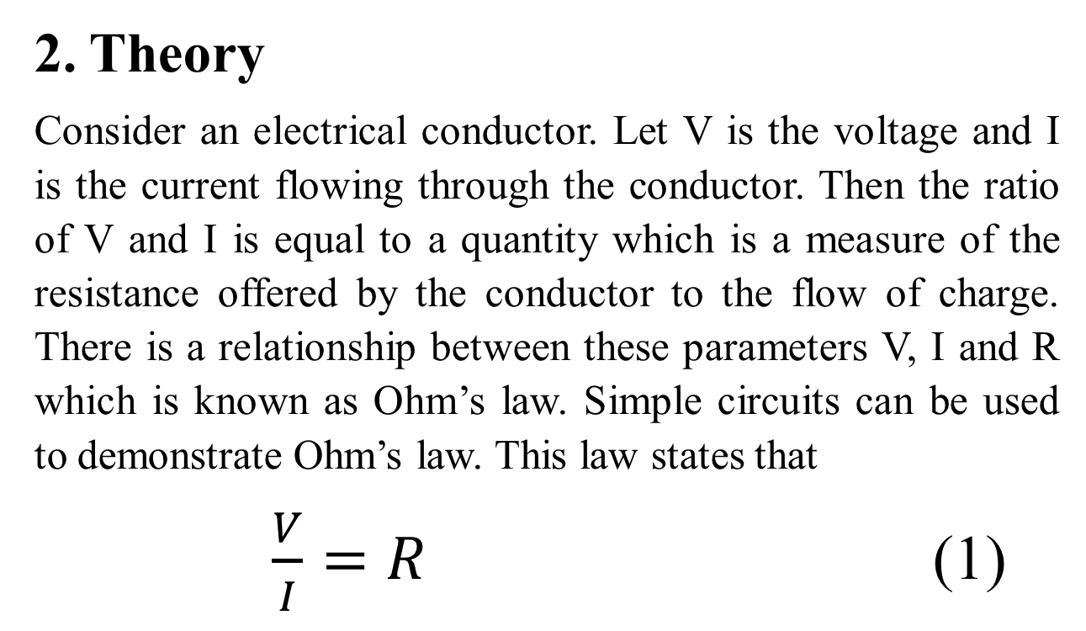
2. Theory
Consider an electrical conductor. Let V is the voltage and I is the current flowing through the conductor. Then the ratio of V and I is equal to a quantity which is a measure of the resistance offered by the conductor to the flow of charge. There is a relationship between these parameters V, I and R which is known as Ohm’s law. Simple circuits can be used to demonstrate Ohm’s law. This law states that
$\frac{V}{I}=R$ (1)

Slide 5
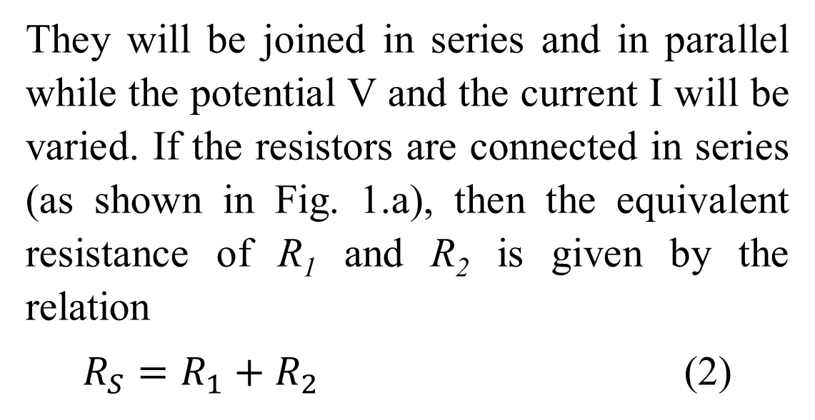
They will be joined in series and in parallel while the potential V and the current I will be varied. If the resistors are connected in series (as shown in Fig. 1.a), then the equivalent resistance of R₁ and R₂ is given by the relation
$R_{S}=R_{1}+R_{2}$ (2)

Slide 6
3. AIMS AND OBJECTIVES
Aims of this experiment are to:
practically verify the law of combination of resistances in series;
apply Ohm’s law by means of drawing appropriate graph to obtain values of net resistances in a simple circuit.

Slide 7
4. Procedure
Identify all apparatus.
Connect the circuit as shown in Fig. 3. with R₁ and R₂ in series.
Make all connections tight.
Adjust the Rheostat (R_{h}) and obtain a series of six readings of current I₁ and voltage V₁ from the Ammeter and Voltmeter respectively.
Now connect R₁ and R₂ in parallel.
Repeat the steps 3 and 4 to obtain six new sets of values of current I₁ and voltage V₁.

